Slide 1
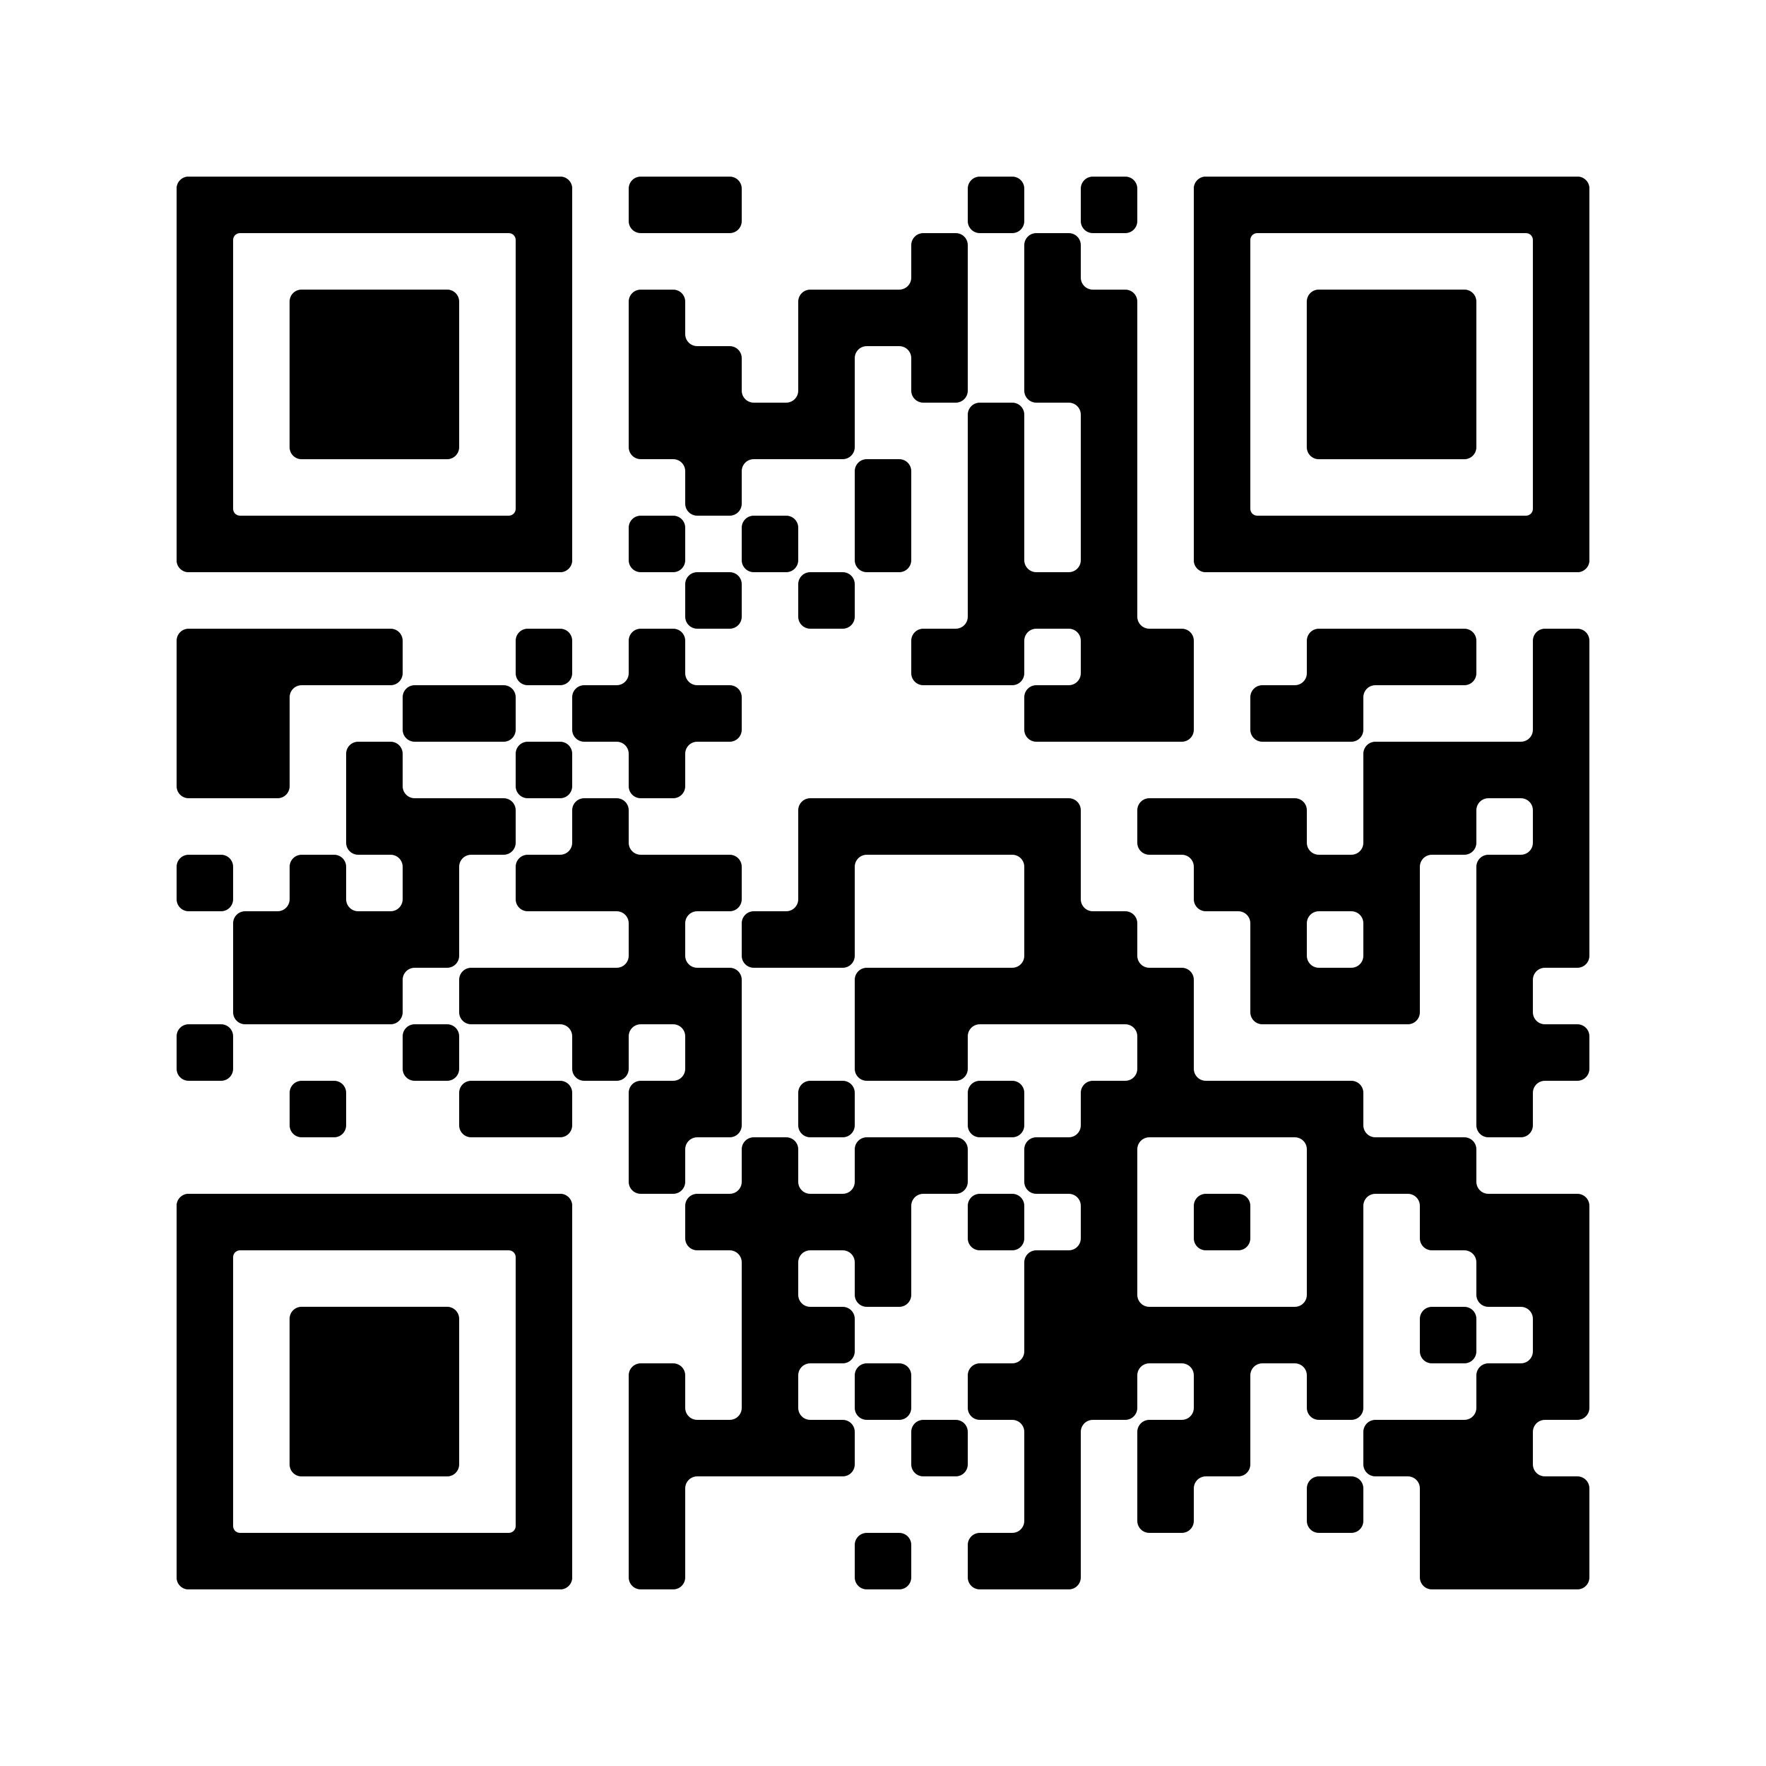
strengthening
families
strengthening
communities
Every Thursday from 16th January 2025 for 12 sessions, excluding school holidays. Last session on April 3rd.
9.30am to 12pm, Settlement Site, Ducie Road, BS5 0AX
A free, inclusive course to help parents and carers raise happy, confident children, from babies to teens
FREE CRECHE SPACES AVAILABLE, BOOK NOW!
“Really valuable course. I have seen genuine changes in my family. I’m very grateful and hopeful for the future”
Parents: self-refer
by scanning
the QR code:
For more information or to book, call Sally on 0117 3041400 extension 155
Professionals: find a referral form at https://form.jotform.com/222903517095355
www.wellspringsettlement.org.uk info@wsb.org.uk
Settlement Site, 43 Ducie Road, BS5 0AX - 0117 3041400
Wellspring Site, Beam Street, BS5 9QY - 0117 304 1400
A company limited by guarantee, registered in England and Wales (05031499) and a registered charity (1103139)

